Slide 1
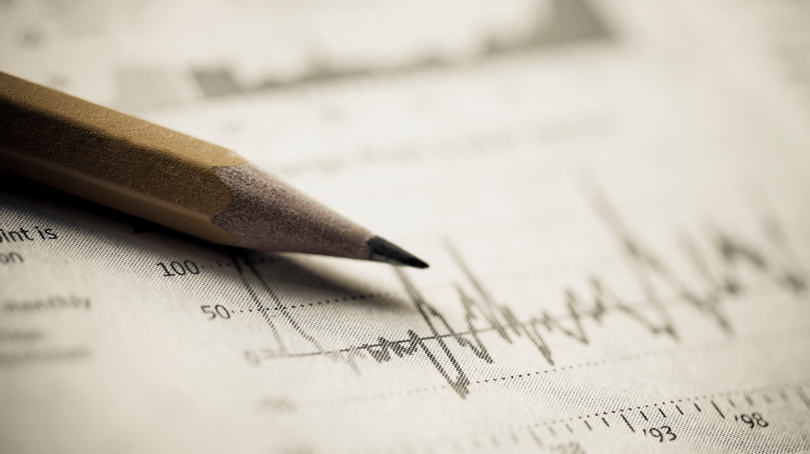
Diabetes Classifier

Slide 2
Business Understanding
In this dataset, There are female patients with diabetes. There are many readings that helps to know if the person have diabetes or not. We will use these readings to make a classifier to predict if the person has diabetes or not.

Slide 3
Data Understanding
Firstly, I imported the dataset. Then, I started to read and understand the data. I found that:
We have 768 Rows and 9 columns.
There is no Nan Values.
All the columns in right format.
There are columns have 0 in its values and this is illogically. The Columns: Glucose, BloodPressure, SkinThickness, BMI and a very big problem in Insulin column.

Slide 4
The last thing, I tried to understand the columns meaning well. Some were easy to understand but other columns, I needed a help of pharmacist to understand the business better.
1-Pregnancies ---> The number of pregnancies.
2-Glucose ---> is the main sugar found in your blood and measured by getting a spot of blood.
3-BloodPressure ---> Blood pressure is a measure of the force that your heart uses to pump blood around your body.
4-SkinThickness ---> Triceps skin fold thickness (mm)
5-Insulin ---> Insulin is a hormone created by your pancreas and measured by blood test.
6-BMI ---> Body Mass Index
7-DiabetesPedigreeFunction ---> Diabetes pedigree function
8-Age ---> The age of every person.
9-Outcome ---> The result if he has diabetes or no.

Slide 5
Data Cleaning
As I found that there are illogically 0 values and big outliers in some columns which they are:
Glucose
BloodPressure
SkinThickness
BMI
Insulin
I removed the Zeros from them and it was an effective move.

Slide 6
Data Analysis
Some insights from the data:
Diabetes comes to people of age from (21 --> 31) and from (40 --> 45).
People who have diabetes, have high blood pressure.
When Glucose reading is more then 120, we should take care.
People with BMI more than or equal 30 have high chance to get diabetes.
People with diabetes has high skin thickness.

Slide 7
Data Analysis
Some insights for Modeling:
This data is imbalanced.
Insulin reading is not a perfect feature for taking a decision but not bad.
Pergnancies and DiabetesPedigreeFunction as they are not clear enough to use.
There are many outliers in Insulin column.
I may need polynomial features.
The Highest correlation with the outcome is Glucose.
Scaling may not be effective.

Slide 8
Data Preparation
I dropped 3 columns as they are not clear enough and it was effective move.
I used validation set approach. So, I split the data and made random state = 44 to make all calculation on the same seed.
I used standard scaler, but it wasn’t important as there is no high variation in the data.

Slide 9
Models Used
Logistic Regression
K Nearest Neighbors Classifier
Decision Tree Classifier

Slide 10
Evaluation of Models
 | Logistic Regression | KNN | Decision Tree
Accuracy | Test Accuracy: 81.25 % | Test Accuracy: 73.95 % | Test Accuracy: 78.12 %
Confusion Matrix | [[110, 5], [ 31, 46]] | [[105, 10], [ 40, 37]] | [[108, 7], [ 35, 42]]

Slide 11
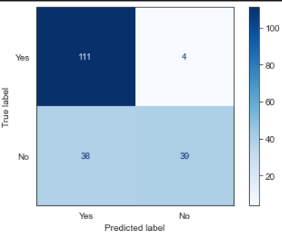
The Best Model
After adding polynomial feature, removing the outliers and unclear columns, The best model is Logistic Regression Model.
Test Accuracy: 78.125 %
Confusion Matrix:[[111, 4],
[ 38, 39]]
WHY???!!!!

